Slide 1
Over-Fitting for Machine Learning Problem
Maryam Zubair

Slide 2
Problem:
Given a problem with two models i.e., Linear and nonlinear for which we had to choose the best model based on how accurate it will make predictions.
In order to find predicted values, I have calculated parameters (Slope and Intercept) for each model and put these values in the relevant equation to see which line will best fit to the dataset. Then predicted which model is better based on the Mean Squared Error calculated for each model.

Slide 3
Formulas:
Linear Model:
Regression equation: y = a + bx
Slope: b = (NΣXY - (ΣX)(ΣY)) / (NΣX2 - (ΣX)2)
Intercept: a = (ΣY - b(ΣX)) / N

Slide 4
Formulas:
Non- Linear Model:
Regression equation: y = a + b(x)^2
Slope: b = (NΣPY - (ΣP)(ΣY)) / (NΣP2 - (ΣP)2)
Intercept: a = (ΣY - b(ΣP)) / N

Slide 5
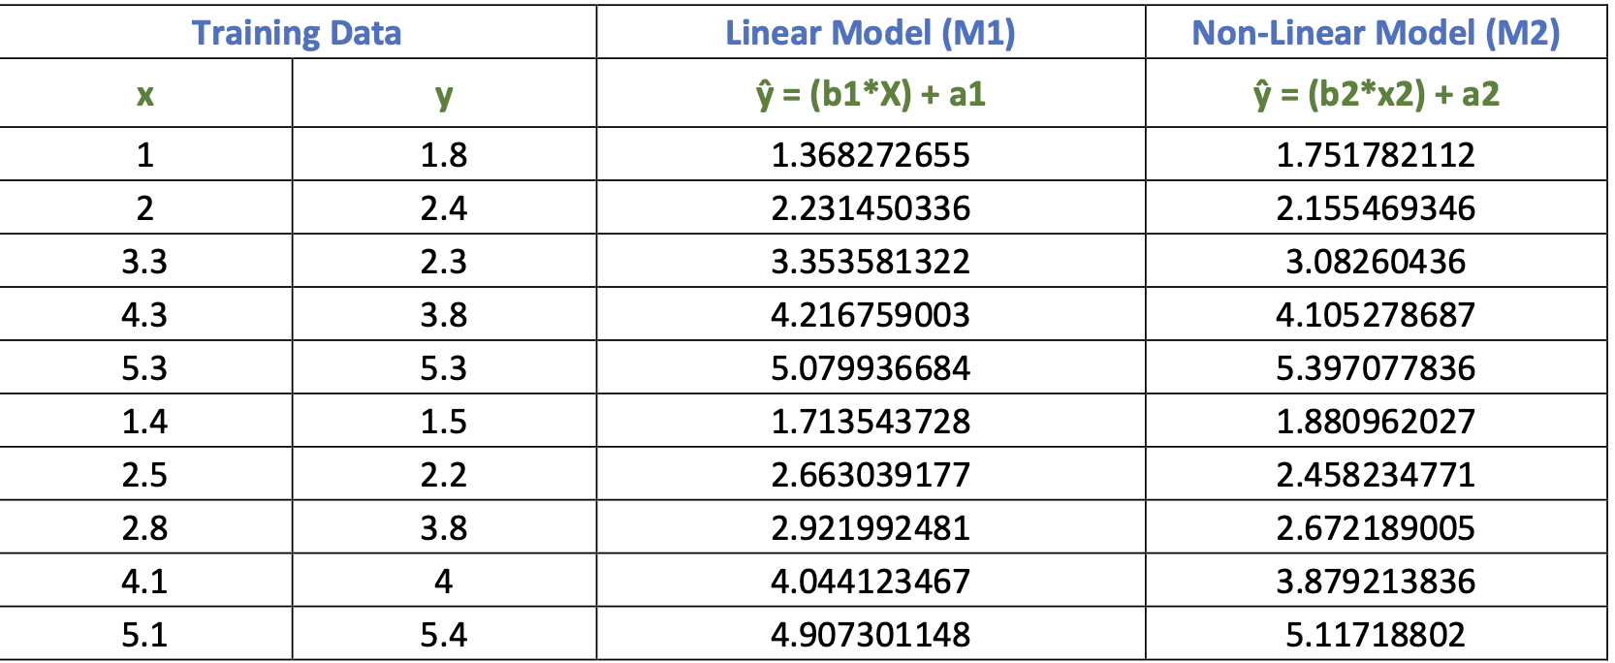
Training Data

Slide 6
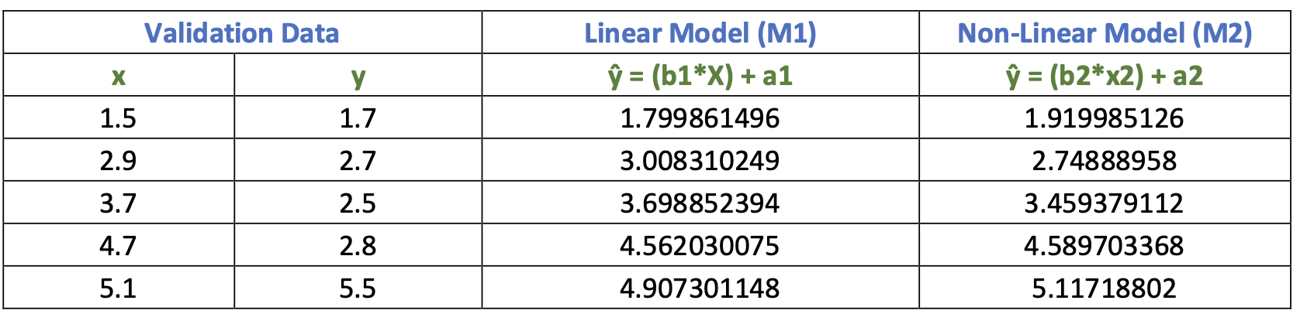
Validation data

Slide 7
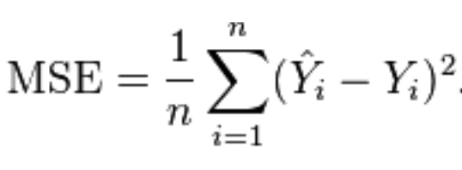
Mean Squared Error:
Mean squared error (MSE) is a commonly used metric to evaluate the performance of a predictive model.

Slide 8
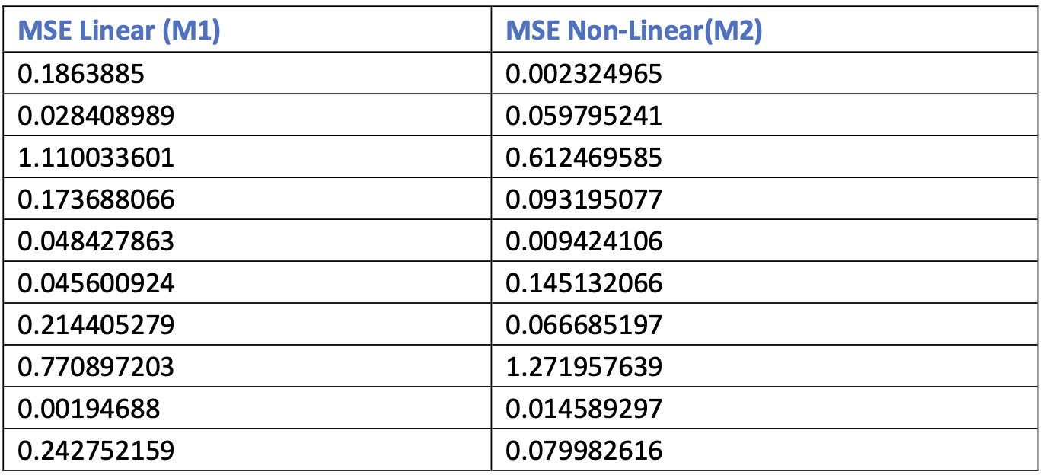
Cost Function/ Mean Square Error for Training Data:
MSE for Linear Model = 2.822/10 = 0.28 MSE for Non-Linear Model = 2.355/10 = 0.235

Slide 9
Comparison ( Linear Model Vs Non-Linear Model)
Model 1:
Max (Training Set, Validation Set) / Min (Training Set, Validation Set) = 0.499/ 0.28 =1.77
Model 2:
Max (Training Set, Validation Set) / Min (Training Set, Validation Set) = 0.432/ 0.235 =1.83

Slide 10
Result
“ As Mean Squared Error tells how close the fitted line to the data point is so smaller the MSE the better the Model. In this given question Linear Regression is a better Model than Non- Linear Model. “
A lower MSE indicates that the model is making predictions that are closer to the true values, and therefore the model is considered to be better.

